Slide 1
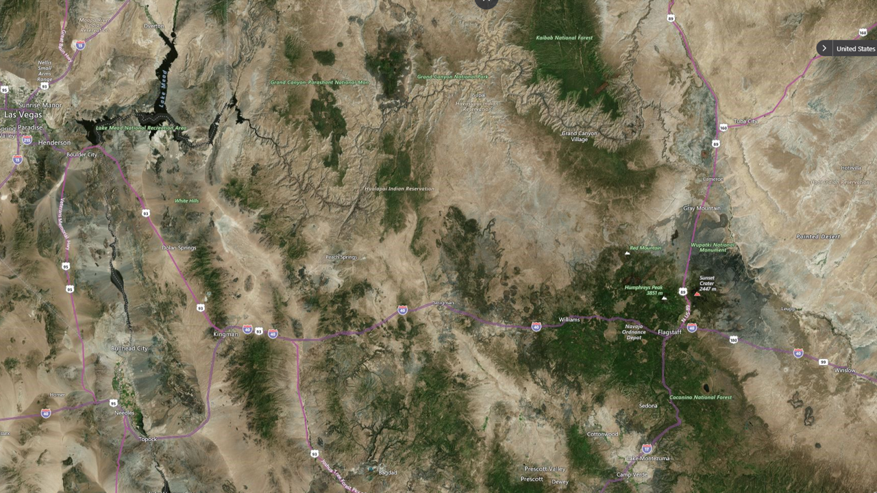





Slide title 8
Forget Something?!

